Slide 1

Discount Helper
Elif Çalışkan

Slide 2
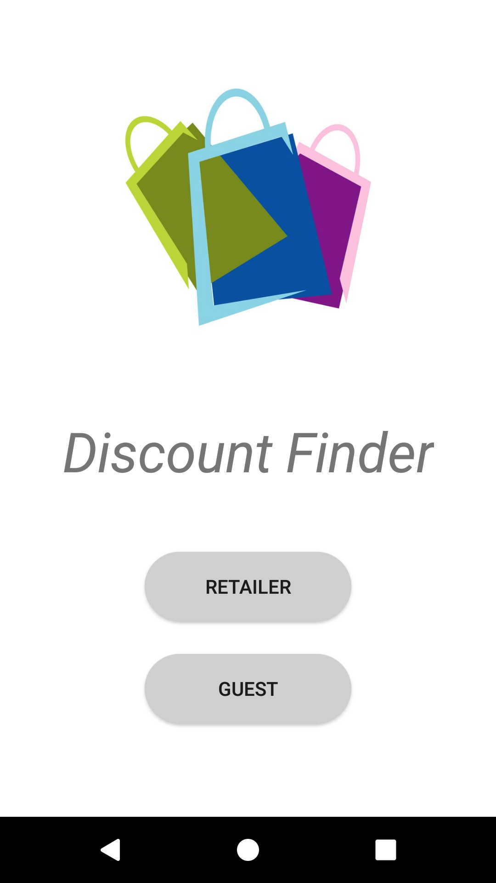

Project
This project aims to show the discounts near the user.
Every store and discount in this system is added by a registered retailer.
A guest user can only see the selected store’s discount.

Slide 3
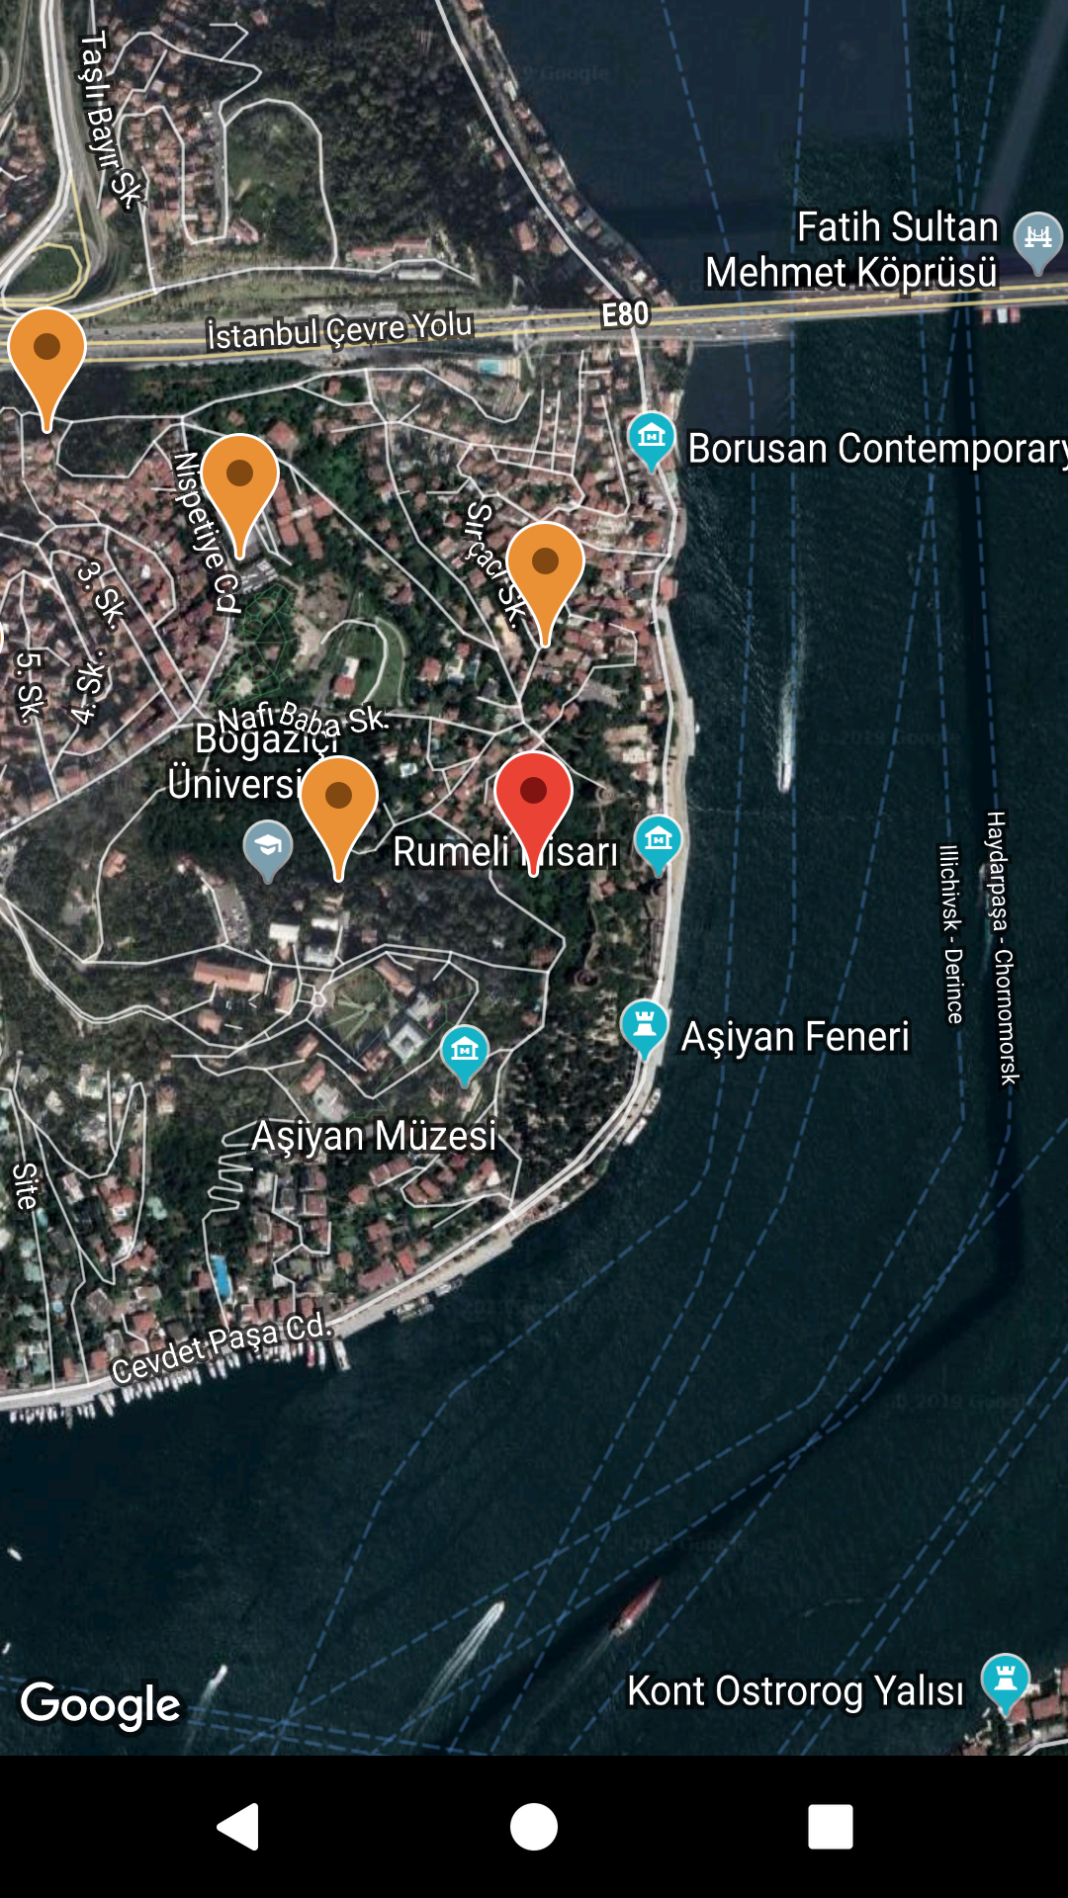
MOtıvatıon
Because of the increasing inflation rates, it is necessary to follow discounts these days. It is a simple app to keep track of these discounts.
This is the guest layout.

Slide 4
Server
TCP Sockets using Port 6000
3 models for : User, Store, Discount
Retailer => name, email, id, password
Store => name, address, latitude, longitude, id, retailer id list
Discount => product, percent, id, store id

Slide 5
Server
Database => “stores.json”, “users.json”, “discounts.json”
BinarySemaphore while writing to each of them
ServerSocket serverSocket = new ServerSocket(port);
while (true) {
Socket socket = serverSocket.accept();
Server thread = new Server(socket);
threads.add(thread);
thread.start();
}

Slide 6
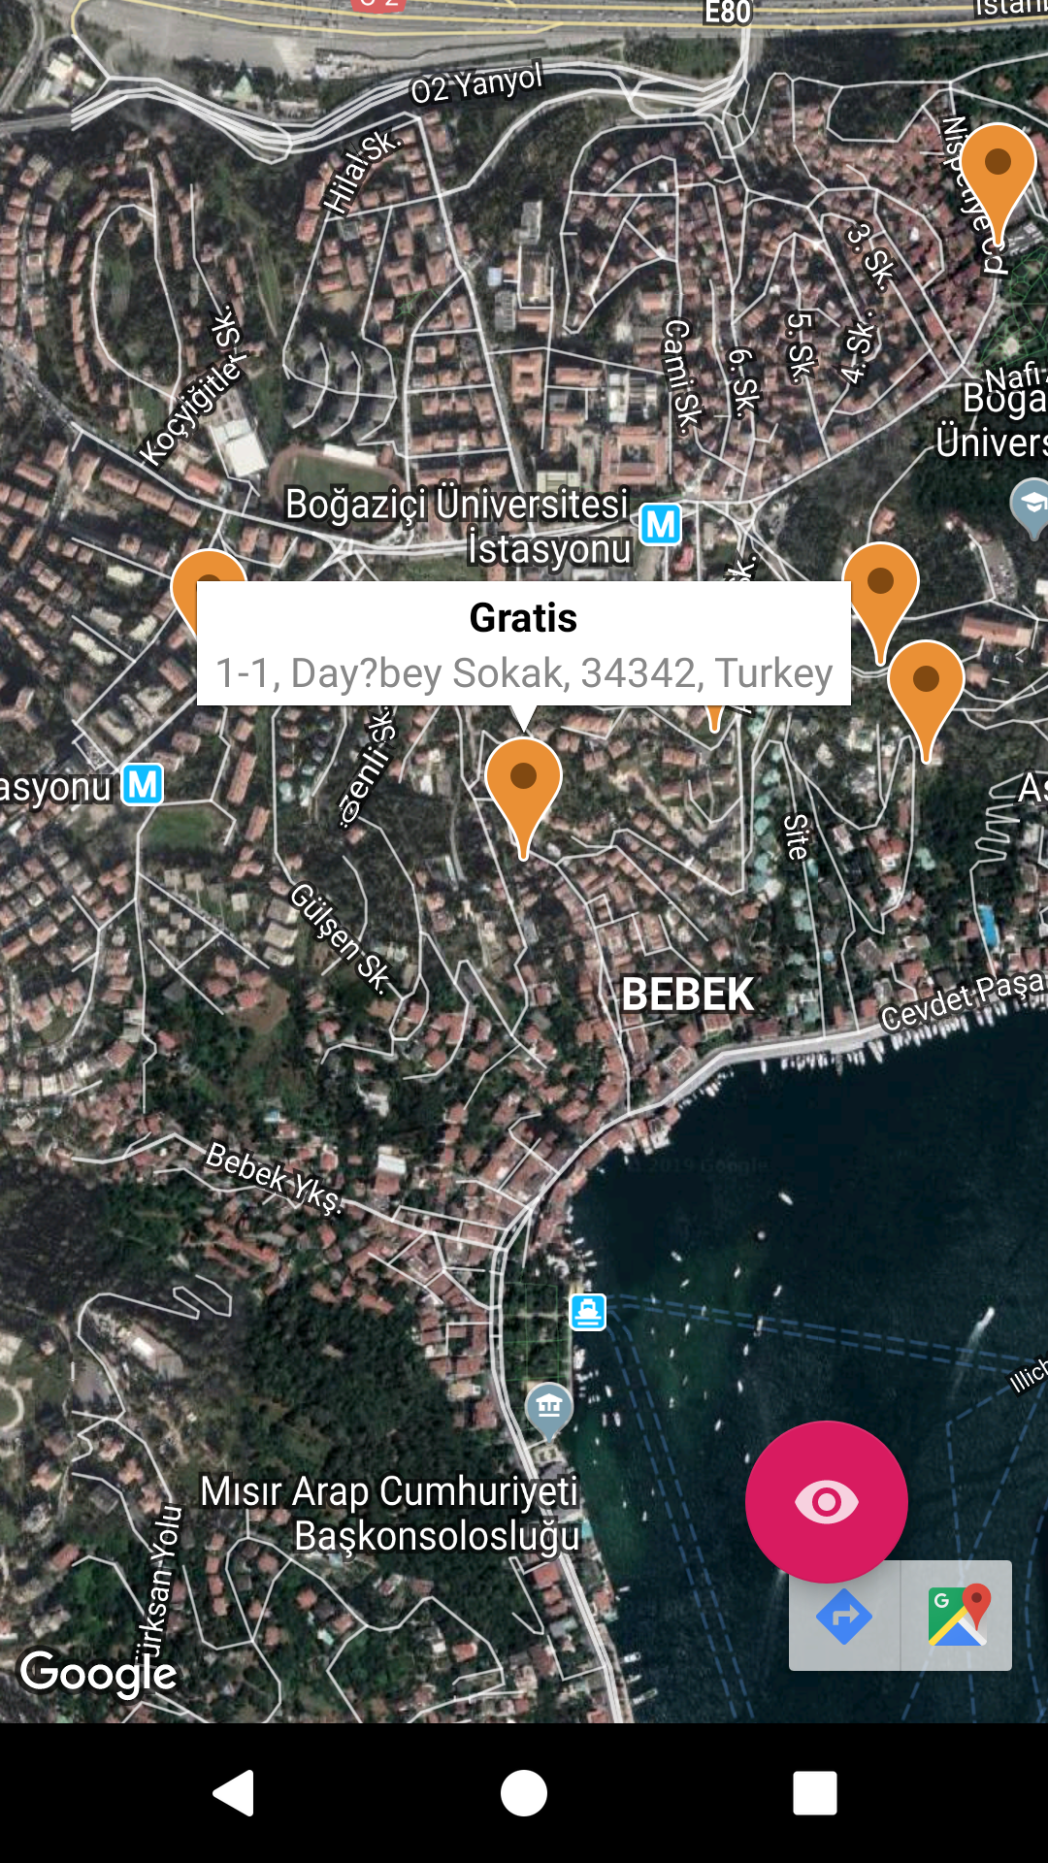
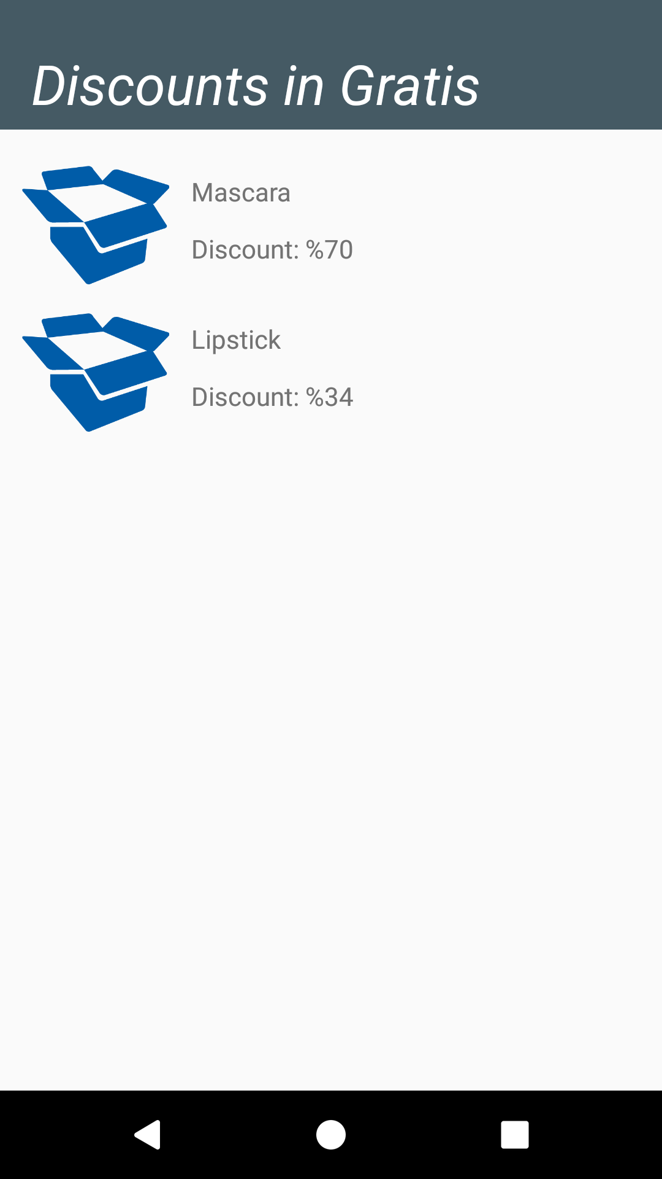
GUEST

Slide 7
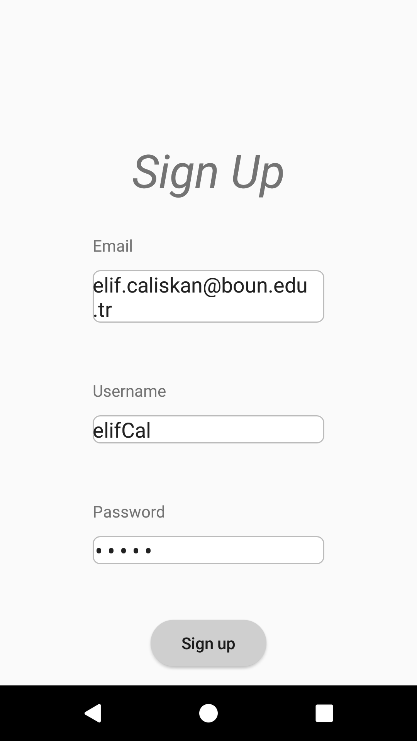
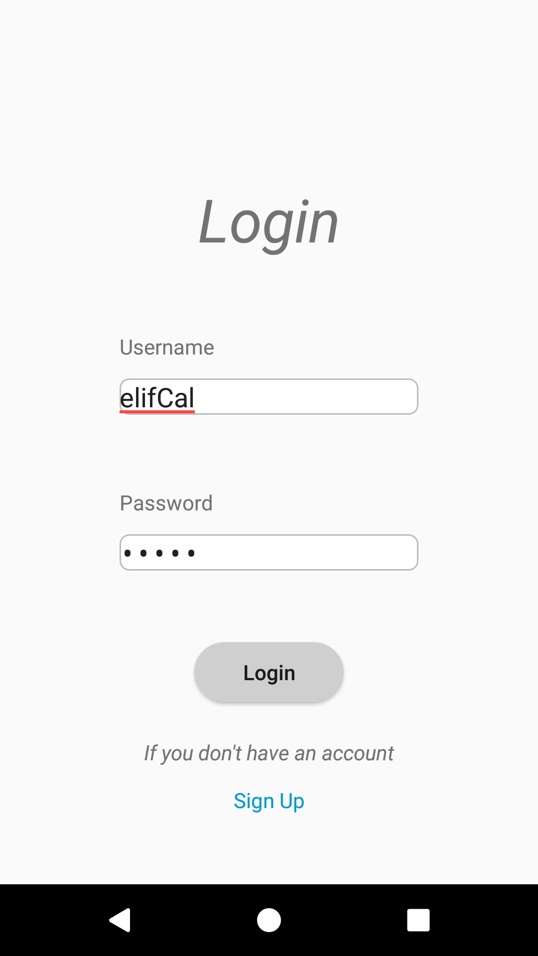
Retailer

Slide 8
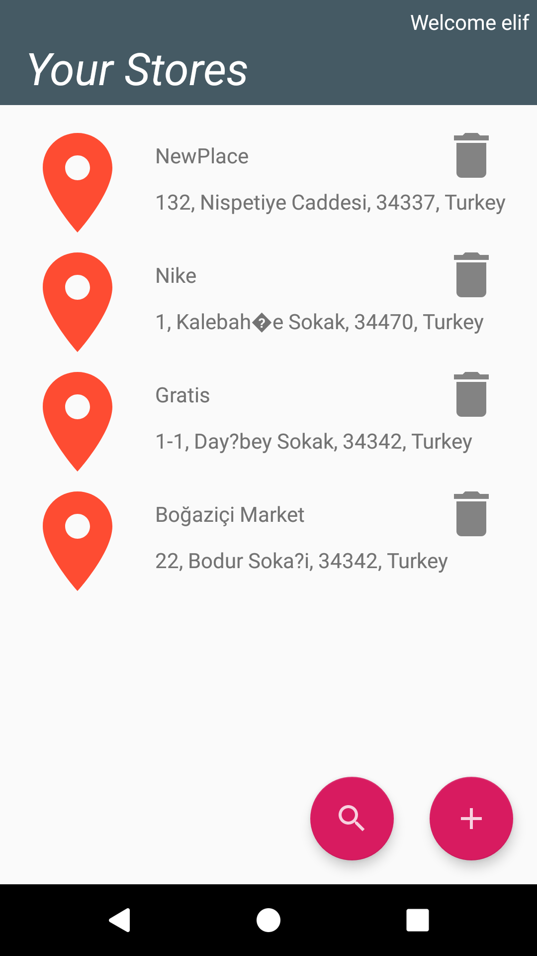
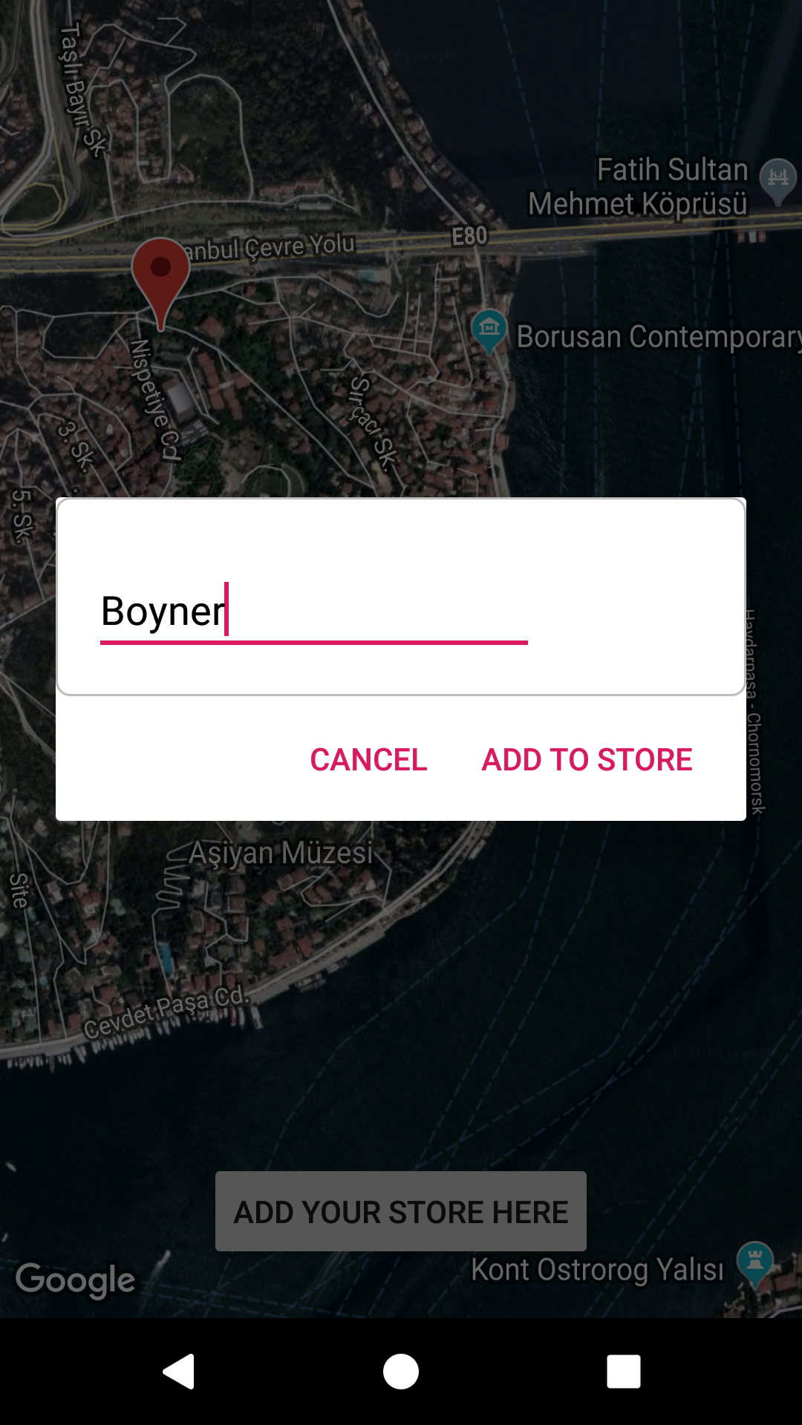
Stores

Slide 9
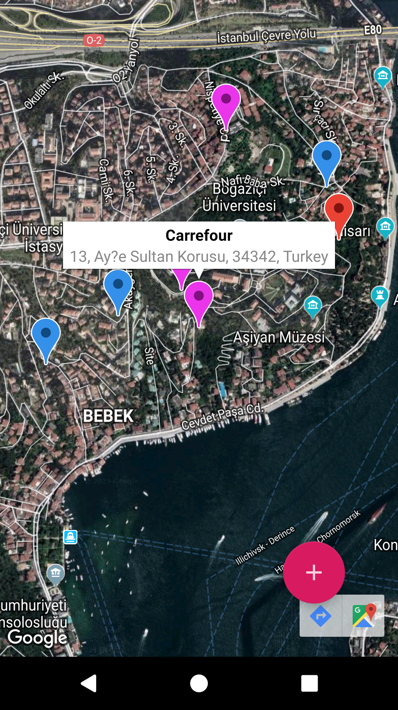
Stores

Slide 10
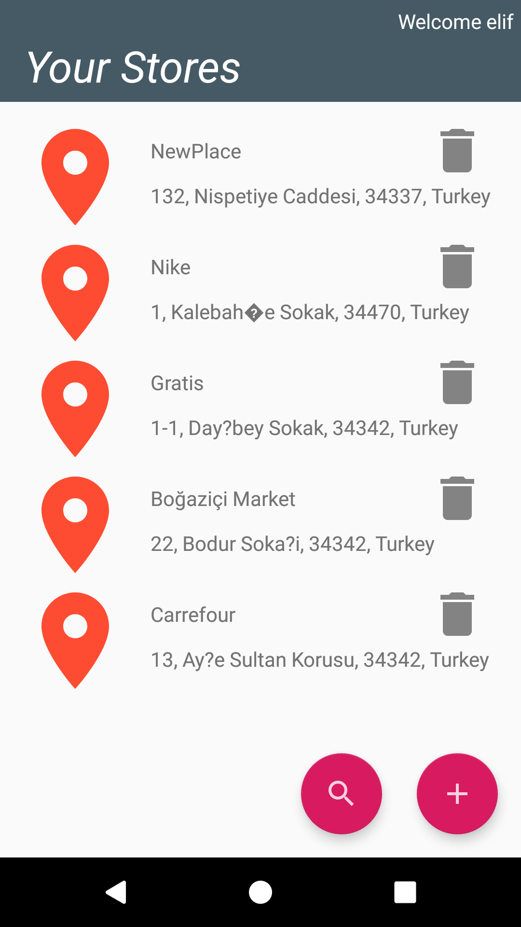
Stores

Slide 11
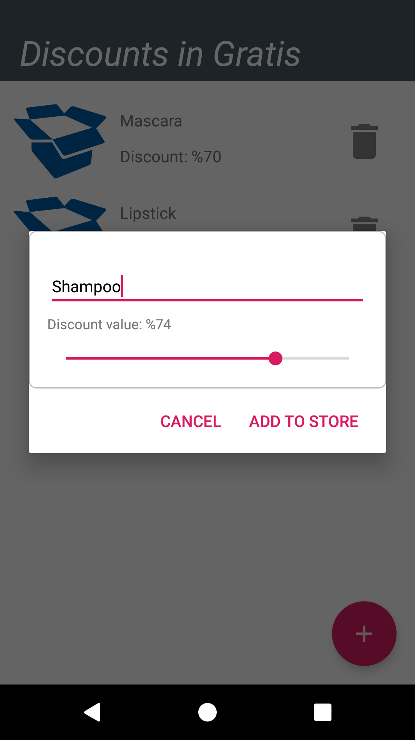
DISCOUnts

Slide 12
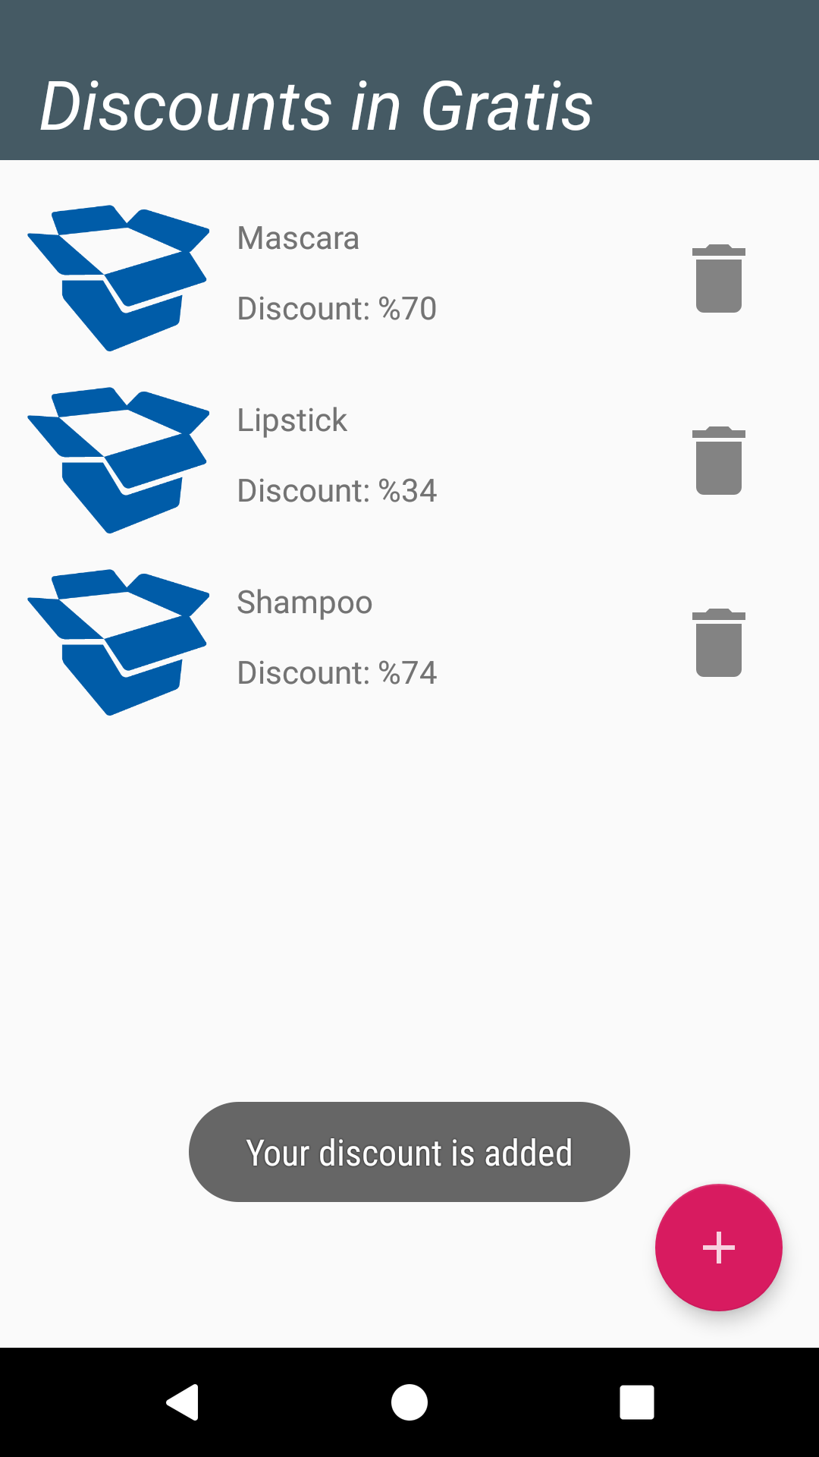
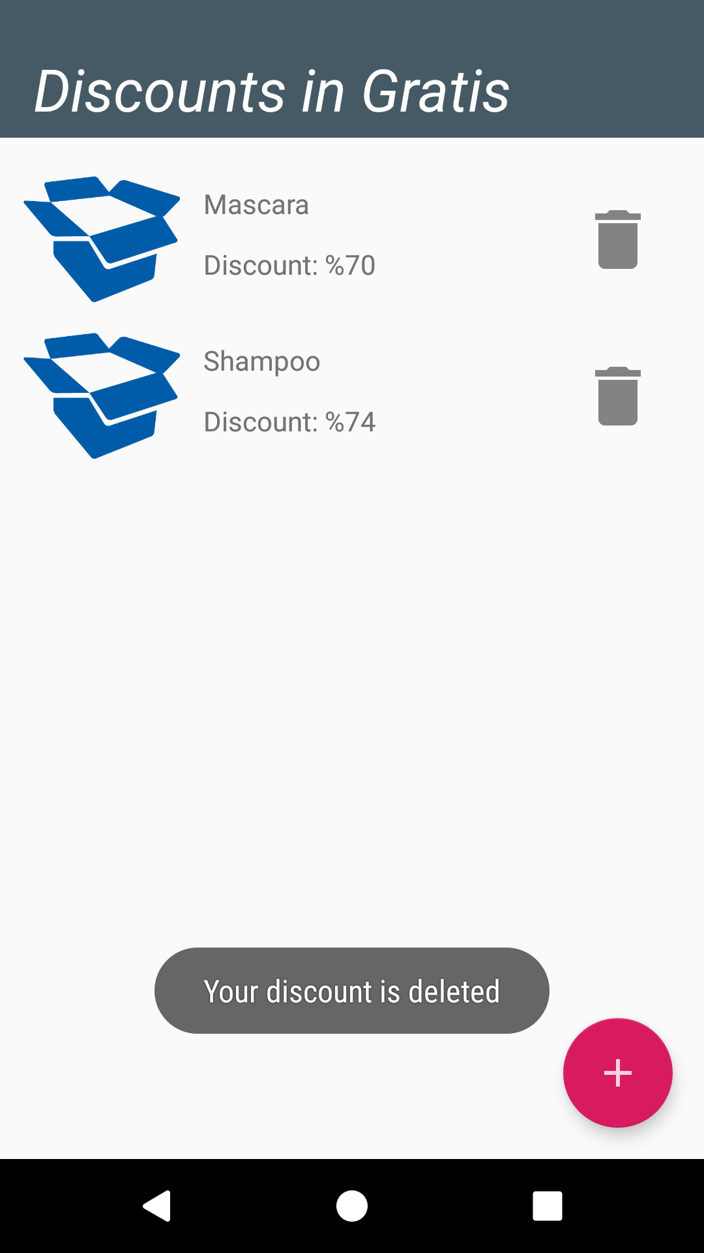
DISCOUnts

Slide 13
Mobile
Activities:
MainActivity (retailer – guest selection)
LoginActivity (username and password)
SignupActivity (email username and password)
MapsActivity (guest see stores- retailer add store- retailer add ownership)
RetailerActivity (add store, delete store)
DiscountActivity (add discount, delete discount)
Models:
Retailer
Store
Discount

Slide 14
Mobile
Communication with AsyncTask
MessageSender class:
Socket("3.125.41.217", 6000);
PrintWriter pw;
InputStreamReader isr;
BufferedReader br;
Different Codes:
100 add retailer
101 add store
102 add discount
103 login
104 get all stores
105 get retailers stores
106 get stores discounts
107 delete discount
108 delete store
109 add ownership

Slide 15
Mobile
Util:
DiscountAdapter : to display discounts and handle delete event
DiscountAddDialogFragment: to add discount
MessageSender: to communicate with server
StoreAdapter: to display stores and handle delete event
StoreNameDialogFragment: to add store

Slide 16
Discount Helper
Thank you for listening!

